Slide 1
WEB APPLICATION DEVELOPMENT TRAINING
WEEK 6 DAY 4 LECTURE SLIDES
PHP SESSION, COOKIES, DATABASE CONNECTION

Slide 2
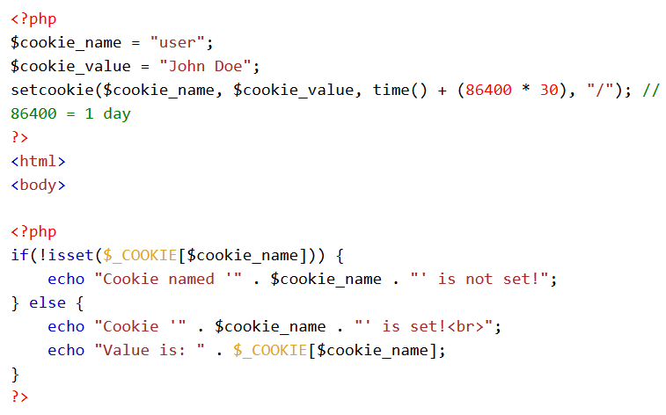
Cookies

Slide 3
Exercise
Using cookies, implement a login for the class management app, maintain a login for the user who entered username and password as “student” | “student”
Delete the cookie by setting a data that has expired.
setcookie( “username", "", time()- 60, "/","", 0);

Slide 4
PHP Session
A session is a way to store information (in variables) to be used across multiple pages.
Unlike a cookie, the information is not stored on the users computer.
Database gives you the opportunity for a more permanent storage
To use session, you must first start it with the session_start() function.
This function first checks if a session is already started and if none is started then it starts one
Session variables are set with the PHP global variable: $_SESSION
The session_start() function must be the very first thing in your document. Before any HTML tags.
Notes:
Make use of isset() function to check if session variable is already set or not

Slide 5
PHP Session
All session variable values are stored in the global $_SESSION variable, they are not passed individually to each new page, they are available in the global variable and can be retrieved from any page
To confirm the availability of session variables, run print_r($_SESSION);
To change a session variable, just overwrite it by assigning the new value to it.
$_SESSION[‘username’] = ‘admin’
Ponder on this: logging in as a new user on most applications will log out the current user.

Slide 6
PHP Session
A PHP session can be destroyed by session_destroy() function
This function does not need any argument and a single call can destroy all the session variables.
If you want to destroy a single session variable then you can use unset() function to unset a session variable unset($_SESSION[‘username']);
To destroy all sessions, use session_destroy();

Slide 7
Exercise
Using the $_SESSION global variable, design a simple login form and maintain the login state for a user across multiple pages. Let your username be ‘student’ and password be ‘student’

Slide 8
Data Persistence : Database Connection
With PHP, you can connect to and manipulate databases.
MySQL is the most popular database system used with PHP. MySQL uses the standard database language. What is it?
PHP combined with MySQL are cross-platform (you can develop in Windows and serve on a Unix platform)
Before we can access data in the MySQL database, we need to be able to connect to the server: Compare how you access your db with HeidiSQL

Slide 9
Database Connection
Earlier Versions of PHP used MySQl, this was deprecated in 2012. MySQLi is now being used
You connect to your MYSQL database using PHP with the mysqli_connect() function
This function returns a MySQL link identifier on success or FALSE on failure.
mysqli_connect($servername, $username, $password, $dbname)

Slide 10
Let Your PHP Talk to Your Db!
<?php
$servername = "localhost";
$username = "username";
$password = "password";
$dbname = “demoapp”;
// Create connection
$conn = mysqli_connect($servername, $username, $password,$dbname);
If($conn){
  echo “You have successfully connected to your db”.}
  Else{ echo Mysqli_connect_error();
}
  }?>
Notes:
Exercise: Connect to any of the db you created using the right credentials, change the credentials , what do you see?
Mysql_error() function

Slide 11
Database Connection
The connection will be closed automatically when the script ends. You can disconnect from MySQL database anytime using another PHP function mysql_close(). This function takes a single parameter, which is a connection returned by mysql_connect() function.
Syntax:
mysql_close ( resource $link_identifier );
mysqli_close($conn);

Slide 12
Running Database Queries
To insert data into MySQL table, you would need to use SQL INSERT INTO command
Syntax : mysqli_query($conn, “YOUR SQL QUERY HERE”);
Exercise: Insert student registration details into the students table of the Class Management App

Slide 13
Get ID of The Last Inserted Record
If we perform an INSERT or UPDATE on a table with an AUTO_INCREMENT field, we can get the ID of the last inserted/updated record immediately
Syntax is : mysqli_insert_id($conn)
Exercise: hands on

Slide 14
Executing multiple queries
Multiple SQL statements must be executed with the mysqli_multi_query() function
mysqli_multi_query($conn, $sql) where $sql is a string of SQL queries contatenated but each terminated by a semicolon.

Slide 15
Some Practical Applications of SESSION
Login and Logout
Form Data Retention
Saving Error Message

Slide 16
The SELECT statement
Used to select data From a MySQL Database
The mysqli_num_rows($result) is used to get the number of rows in a db table where $result is the outcome of an executed mysqli_query on SELECT statement

Slide 17
mysqli_fetch_assoc(), mysqli_fetch_array(), mysqli_fetch_rows()
The three are used to fetch data from a result set one record per time.
mysqli_fetch_array($res) gets the record as both associative and as index arrays
mysqli_fetch_row() gets the record a an index array
mysqli_fetch_assoc() gets the record as an associative array
Discover your favorite and stick to it!
Mysqli_num_rows() – To get the total number of records

Slide 18
Exercise
Modify the existing code in the previous class exercise to determine the number of times a user logged in successfully to his account.
Assume the correct username and password is “student” | “student” respectively
Receive the user’s input from the login form, compare the input with the username and password above. If correct, insert the time and other server details into your login table

Slide 19
Useful PHP Functions
PHP Redirect with header() : The header function sends a raw HTTP header to a client.
You can use the header() function to send a new HTTP header, but this must be sent to the browser before any HTML or text.
Syntax is header(“location:$url”);
$_SERVER['REMOTE_ADDR'] : Returns the IP address from where the user is viewing the current page
$_SERVER['REMOTE_HOST'] : Returns the Host name from where the user is viewing the current page
Put curly brackets when you want to insert an array value directly into a string. Eg echo “This is my favourite {$menu[0]}”;
Explode() and implode() functions
Notes:
Its good to end it with the die() statement

Slide 20
Exercise:
Using the INSERT statement, create a table to store the multicity data.
Using Select Statement, mysql_fetch_array() or mysql_fetch_assoc(), display the contents of the db table in a responsive table with stripes

Slide 21
Classwork
The MD5() function in PHP allows you to encrypt values
Create a user sign up form, encrypt your user’s password and save in the appropriate table on the Class Management App database

Slide 22
PHP date Function
Syntax is date(format, timestamp)
Refer to http://php.net/manual/en/function.date.php for a complete reference on the various format possible.
The Datetime class can also be used for PHP version 5.3 or higher

Slide 23
PHP File Upload
Information in the phpinfo.php page describes the temporary directory that is used for file uploads as upload_tmp_dir and the maximum permitted size of files that can be uploaded is stated as upload_max_filesize. These parameters are set into PHP configuration file php.ini
First, ensure that PHP is configured to allow file uploads. In your "php.ini" file, search for the file_uploads directive, and set it to On

Slide 24
PHP File Upload
Creating HTML form for file upload:
  Make sure that the form uses method="post"
  The form also needs the following attribute: enctype="multipart/form-data". It specifies which content-type to use when submitting the form
<form action="upload.php" method="post" enctype="multipart/form-data">
Initially files are uploaded into a temporary directory and then relocated to a target destination by a PHP script

Slide 25
PHP File Upload
As usual when writing files it is necessary for both temporary and final locations to have permissions set that enable file writing. If either is set to be read-only then process will fail

Slide 26
Your File Upload Script
There is one global PHP variable called $_FILES. This variable is an associate double dimension array and keeps all the information related to uploaded file.
So if the value assigned to the input's name attribute in uploading form was file, then PHP would create following five variables −
$_FILES['file']['tmp_name'] − the uploaded file in the temporary directory on the web server.
$_FILES['file']['name'] − the actual name of the uploaded file.
$_FILES['file']['size'] − the size in bytes of the uploaded file.
$_FILES['file']['type'] − the MIME type of the uploaded file.
$_FILES['file']['error'] − the error code associated with this file upload.

Slide 27
PHP File Upload
MIME stands for "Multipurpose Internet Mail Extensions. It's a way of identifying files on the Internet according to their nature and format
See below for a full list of the MIME types
https://www.sitepoint.com/web-foundations/mime-types-complete-list/
The move_uploaded_file() function is used to move the uploaded file from the temporary location to the specified directory in your application.

Slide 28
PHP File Upload
Syntax is : move_uploaded_file(file, newlocation)
File: The filename of the uploaded file.
Newlocation: The destination of the moved file.
Returns TRUE on success.
If filename is not a valid upload file, then no action will occur, and move_uploaded_file() will return FALSE.
If filename is a valid upload file, but cannot be moved for some reason, no action will occur, andmove_uploaded_file() will return FALSE. Additionally, a warning will be issued.

Slide 29
Useful PHP Functions
In_array($element, $array) – to find if $element is contained in $array
Substr()
Sizeof($array) or count($array) to get the number of elements in an array
Basename($file) to get the name of a file without the extension

Slide 30
Handling Multiple File Upload
PHP supports array for files also. The HTML tag for all the file simply need to be named as array. Example
<input type="file" name="pictures[]" /> <input type="file" name="pictures[]" /> <input type="file" name="pictures[]" />
Print_r the arrays to see what appears:
Each of the file variable is captured for the 3 files. (check the note)
Notes:
[pictures] => Array (
[name] => Array (
[0] => Colmar_France.png
[1] => io-d--1000-1446999107.jpg
[2] => Rothenburg_Germany.jpg
)

Slide 31
Handling Multiple File Upload – Code Snippet
foreach($_FILES["pictures"]['name'] as $key=>$value){
$name = $_FILES["pictures"]['name'][$key];
$size = $_FILES["pictures"]['size'][$key];
$tmpname = $_FILES["pictures"]['tmp_name'][$key];
$type = $_FILES["pictures"]['type'][$key];
$error = $_FILES["pictures"]['error'][$key];
echo "Picture $name is of $size<br>";
}
Notes:
Remember how file group appears in PHP
[pictures] => Array (
[name] => Array (
[0] => Colmar_France.png
[1] => io-d--1000-1446999107.jpg
[2] => Rothenburg_Germany.jpg
)

Slide 32
Image Resizing
Imagecreatetruecolor, imagecopyresampled, imagejpeg, imagedestroy etc are PHP inbuilt functions for manipulating images
Read it up, get sample image resizing code online
See me for explanation if stuck.

